Slide 1
Gray level Transformation
There are three basic gray level transformation.
Linear (Negative Transformation)
Logarithmic (Log transformation)
Power – law (Power – Law transformations)

Slide 2
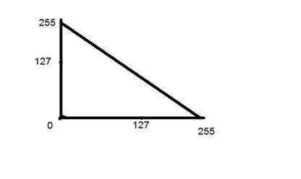
Negative Transformation
Equation of Negative transformation
S = (L-1) - R
S = Negative image
L = Max. intensity can image carry. (Its depend on Bit)
Ex. 8 Bit image, L = 256 which is 2^{8.}
R = Intensity of pixel.

Slide 3
S = (L-1) - R
Original Image
Negative Image
0 | 255 | 127
10 | 250 | 50
200 | 100 | 50
255 | 0 | 128
245 | 5 | 205
55 | 155 | 205
8-bit & (3 X 3) Image

